Slide 1


Deloitte Summer Academy
July 1-4, 2019

Slide 2

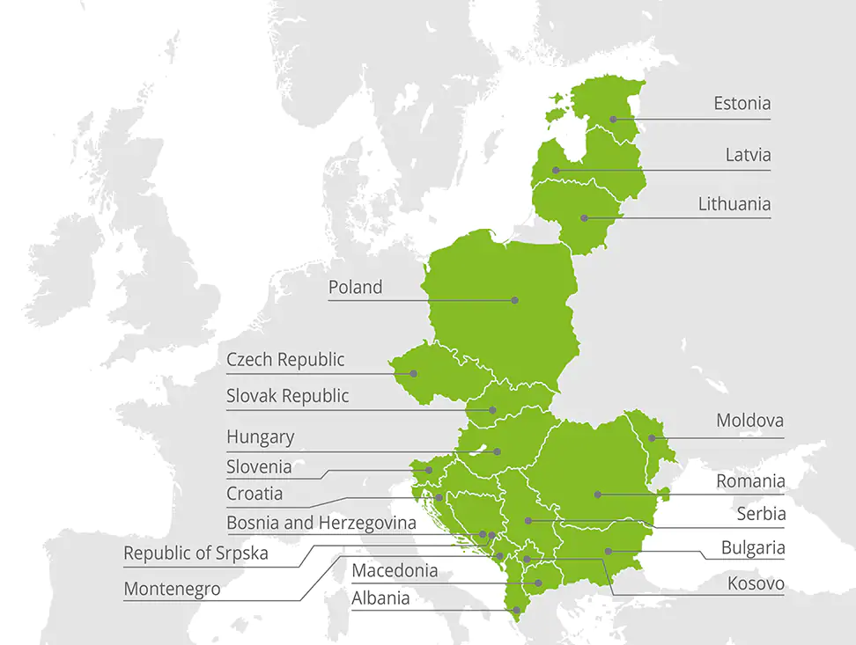

Deloitte Global
Deloitte Central Europe
Deloitte Latvia
The 3rd strongest brand in the world
The strongest and most valuable professional consultancy brand
#1 M&A House in Central Europe
#1 Financial Advisor in Europe and globally by M&A activity
Operating for more than 150 years, offices in more than 150 countries with more than 286,000 employees.
18 countries across Central Europe
More than 4,400 employees
More than 160 employees
Tax
Audit
AIM
Advisory
Legal

Slide 3
Who are we?
Advisory
Consulting, Financial Advisory (M&A, valuation), Data analytics, Forensic services (financial crime, cyber, investigations, disputes)
Legal
Legal advice for companies and individuals, M&A transaction support, GDPR, Litigation and international arbitration
160
Employees in 5 departments in Latvia
AIM
Analytics & Information Management, offering Artificial Intelligence and Big Data solutions
Audit
Deep-dive analysis of market leaders, Top-notch technology, Business focused service, Freedom of development
Tax
Business restructuring, Cross-border transactions, Tax Authorities dealings, Lobbying for legislation changes

Slide 4
What do we offer?
Fast career growth, external and internal trainings, personal coaching
Professional, friendly, supportive, young and energetic colleagues, internal events and gatherings
Work on land-mark transactions and well-known brands
Socially responsible company with several CSR activities
Mobile phone policy – paid monthly contract
Health and travel insurance
Opportunities to work abroad. Freedom and mobility to shift career across business disciplines
Fruit and healthy snacks in the kitchen, well-being initiatives

Slide 5
What are we like?
We are quite young – our average age is 30 years
We are multilingual - we speak more than 3 languages
We communicate in English at least 60% of day
What characteristics we like the most about our colleagues?
It’s easy - they are:
professional
fun
positive
smart
ambitious
helpful
friendly
experienced
intelligent
supportive

Slide 6


When? Where? What?
Language: English
When: 1-4 July 2019
Duration: 4 days
Venue: RGSL, Strelnieku str. 4A, Riga
Day | Topic | Comment
Monday | Introduction to Deloitte and what we do | Meeting with Deloitte managers & Partners. Introduction into: Financial Advisory, Analytics and Information Management (AIM), Financial Service Industry (FSI) and Banking sector. Q&A with Baltic Summer School 2018 graduates.
Tuesday | Audit | What is an Auditor and what they do? What you need to become an Auditor? Participation in an Audit game.
Wednesday | Tax Advisory and Transfer Pricing | Introduction in to Transfer Pricing and Corporate income tax advisory How does taxation impact businesses in everyday life? Case study
Thursday | Tax Advisory + Closing event | Tax advisory – what is there to consult on Value added tax and Personal income tax? Case study Announcement of results and award ceremony Party time! ☺

Slide 7

Why Deloitte Summer Academy?
Test yourself and meet new people
Part of the day will be structured in games and case studies to test such soft-skills as working in group, analytical and critical thinking.
Practical
The material will be case – study based led by top experts from the industry
Totally Free
All expenses are covered and participation is free.
Internship & employment
Best students from the program will be granted immediate paid internship @ Deloitte with the possibility of further employment
A lot of fun
All work and no play makes Johnny a dull boy.

Slide 8
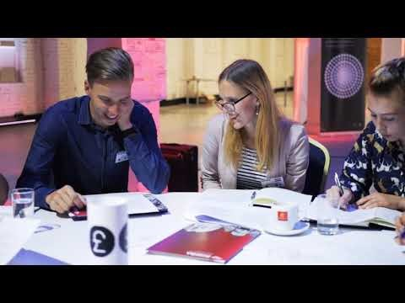
What is it like?
Instead of telling you, how about we show you?

Slide 9
Selection process
What are your next steps?
1st step:
March – May 2019
  We want students with excellent grades in Math, Accounting, Finance
  Apply @ Deloitte with your CV, proof of grades and short motivational letter
2nd step:
May – June 2019
  Test for basic understanding will be held @ Deloitte premises
  Logic
  Analytical skills
3rd step
May – June 2019
  Interviews with the selected candidates
Any questions? Want to sign up? Contact:
Lāsma Priede, e-mail: LPriede@deloitteCE.com

Slide 10
About Deloitte
Deloitte refers to one or more of Deloitte Touche Tohmatsu Limited, a UK private company limited by guarantee (“DTTL”), its network of member firms, and their related entities. DTTL and each of its member firms are legally separate and independent entities. DTTL (also referred to as “Deloitte Global”) does not provide services to clients. Please see www.deloitte.com/lv for a more detailed description of DTTL and its member firms.
In Latvia, the services are provided by SIA Deloitte Latvia, SIA Deloitte Audits Latvia and law firm Deloitte Legal (jointly referred to as “Deloitte Latvia”) which are affiliates of Deloitte Central Europe Holdings Limited. Deloitte Latvia is one of the leading professional services organizations in the country providing services in tax, legal, audit and advisory through over 160 national and specialized expatriate professionals.
© Deloitte Latvia 2019

